Slide 1
Predictive Remaining Useful Life
Estimation of Aircraft Turbofan Engines
Machine Learning Group Activity Presentation
B Tech Computer Science and Engineering Data Science | Semester V
Mentor: Abhay Kolhe
Notes:
Based on the group activity report draft. Team name, course code, year, date, and roll numbers remain to be completed before final submission.

Slide 2
Problem and objective
Question
Given an engine’s sensor history up to today, how many operating cycles remain before simulated failure?
Learning task
Supervised regression. One numerical RUL prediction is evaluated at the final observed cycle of each official test engine.
Notes:
Source: GROUP_ACTIVITY_REPORT_SOURCE.md, sections 2 and 5. The NASA C-MAPSS data are simulated.

Slide 3
Dataset and source files
Four subsets
FD001 and FD003: one operating condition
FD002 and FD004: six operating conditions
Each raw row has 26 numeric fields
Engine ID, cycle, 3 operating settings and 21 sensor measurements
Training trajectories reach failure. Test trajectories stop early. A separate RUL file supplies one answer per test engine.
Notes:
Source: NASA C-MAPSS, docs/SOURCE_PROVENANCE.md, reports/dataset_summary.csv. The FD001–FD004 package differs from the PHM08 challenge train.txt package.

Slide 4
Dataset size
Subset
Train rows
Train engines
Test rows
Test engines
FD001
20,631
100
13,096
100
FD002
53,759
260
33,991
259
FD003
24,720
100
16,596
100
FD004
61,249
249
41,214
248
The official test evaluates one endpoint per engine.
Notes:
Source: reports/dataset_summary.csv. Counts refer to rows and distinct engines, not independent row samples.

Slide 5
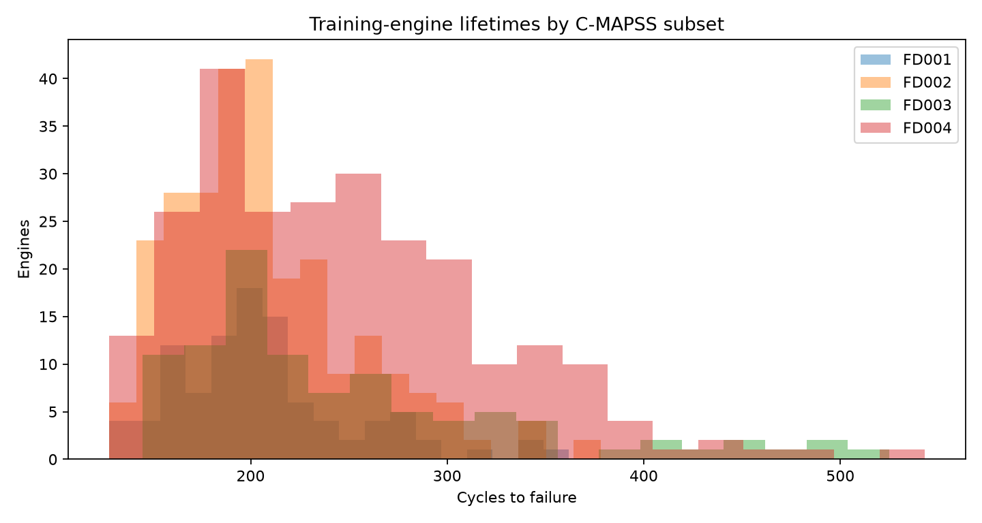
Exploratory data analysis
Median training lifetime
FD001 199 cycles
FD002 199 cycles
FD003 220.5 cycles
FD004 234 cycles
Lifetime varies by engine, so rows from the same engine stay together during validation.
Notes:
Source: reports/eda/engine_lifetimes.png and GROUP_ACTIVITY_REPORT_SOURCE.md, section 7.1.

Slide 6
Preprocessing and feature engineering
Quality checks
Numeric types, missing values, duplicates and engine-cycle order
Training RUL
Final training cycle minus current cycle
Predictors
Cycle, operating settings, retained sensors, one-cycle changes and five-cycle rolling means. Temporal features use current and earlier cycles only.
Notes:
Source: src/cmapss_pipeline.py, train_models.py, GROUP_ACTIVITY_REPORT_SOURCE.md, section 6.3.

Slide 7
Model selection protocol
1 Hold out 20% of training engines
2 Predict one partial-history endpoint per held-out engine
3 Select the lowest validation RMSE within each subset
4 Refit the selected model on all training engines
5 Evaluate once at official test endpoints
Notes:
Source: train_models.py and GROUP_ACTIVITY_REPORT_SOURCE.md, sections 6.4–6.7. Engine ID is a grouping key, not a model input.

Slide 8
Models compared
Median baseline
Constant median RUL reference
Ridge regression
Regularized linear model with training-only scaling
Random Forest
80 regression trees with averaging
Histogram Gradient Boosting
Sequential regression trees, 150 iterations
Notes:
Source: train_models.py and GROUP_ACTIVITY_REPORT_SOURCE.md, section 6.4. Settings were fixed before official-test evaluation.

Slide 9
Validation RMSE and selected models
Subset
Median
Ridge
Forest
Boosting
Selected
FD001
47.51
32.93
27.17
27.31
Forest
FD002
47.55
41.37
33.14
32.16
Boosting
FD003
67.43
53.09
28.13
24.87
Boosting
FD004
58.79
56.47
45.38
45.19
Boosting
The FD001 forest lead is only 0.14 cycles; FD004’s boosting lead is about 0.19 cycles.
Notes:
Source: reports/modeling/FD00X/validation_metrics.csv. Units are cycles. A lower RMSE is better.

Slide 10
Official test results
Subset
Selected model
MAE
RMSE
R²
FD001
Random Forest
21.21
28.68
0.52
FD002
Histogram Gradient Boosting
20.27
27.66
0.74
FD003
Histogram Gradient Boosting
23.89
34.81
0.29
FD004
Histogram Gradient Boosting
27.72
38.50
0.50
These scores describe simulated benchmark engines, not a maintenance-ready system.
Notes:
Source: reports/modeling/official_test_summary.csv. The selected models were chosen on validation data. MAE and RMSE are in cycles.

Slide 11
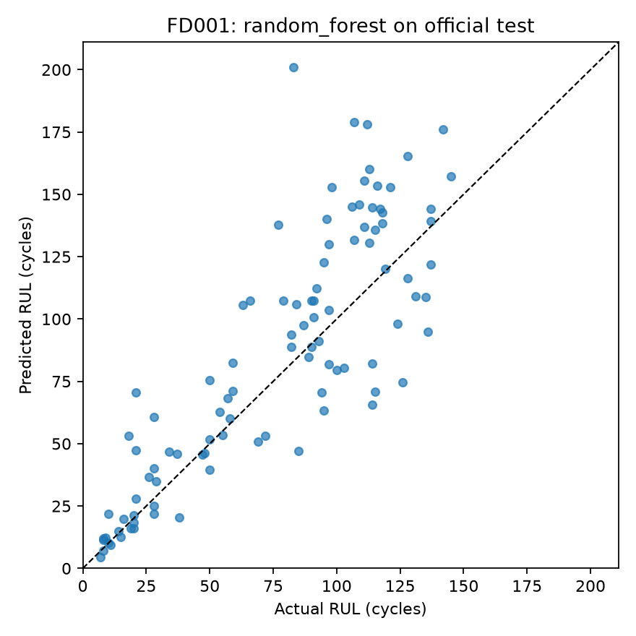
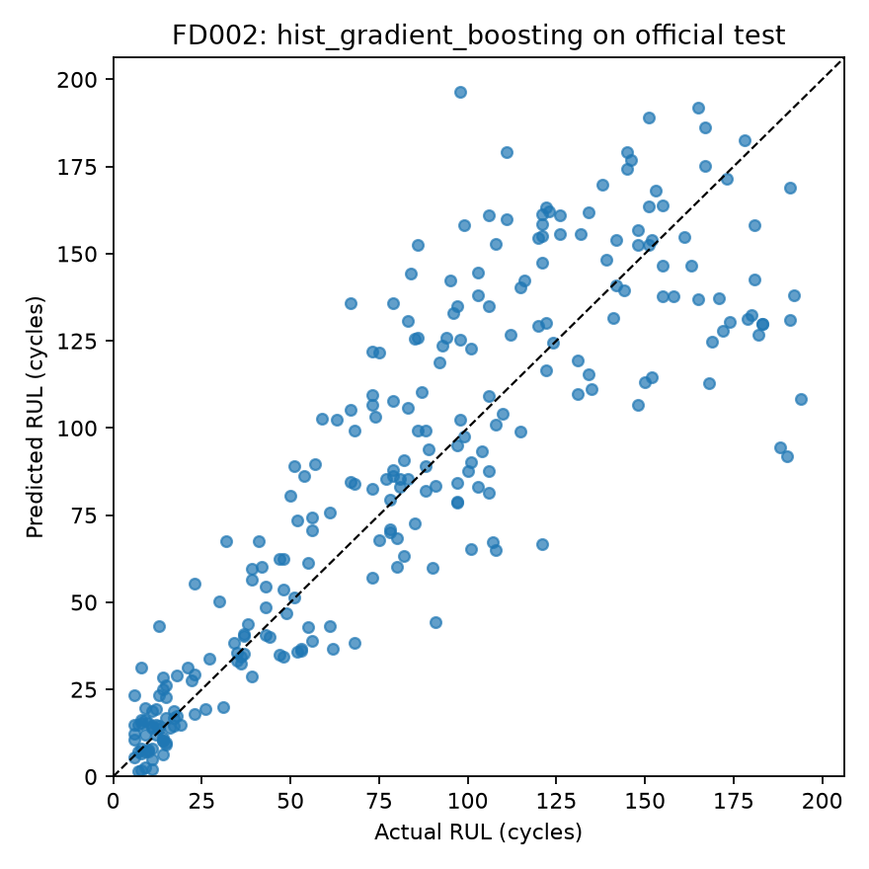
FD001 and FD002 prediction plots
FD001
FD002
Notes:
Source: reports/modeling/FD001/official_test_actual_vs_predicted.png and FD002 equivalent. Each dot is one official test engine.

Slide 12
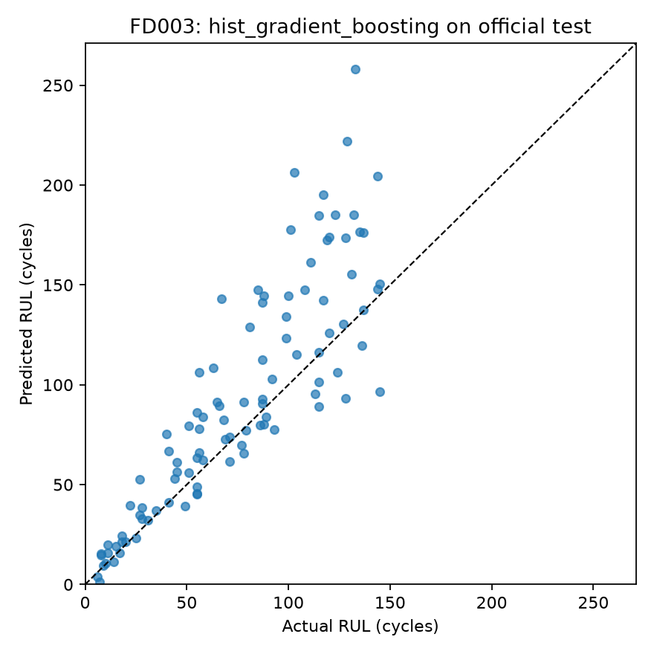
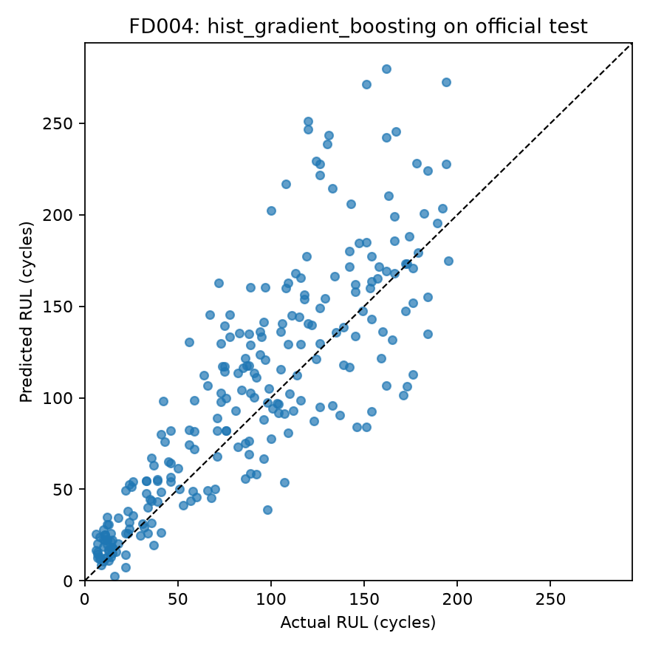
FD003 and FD004 prediction plots
FD003
FD004
Notes:
Source: reports/modeling/FD003/official_test_actual_vs_predicted.png and FD004 equivalent. The dashed diagonal is exact prediction.

Slide 13
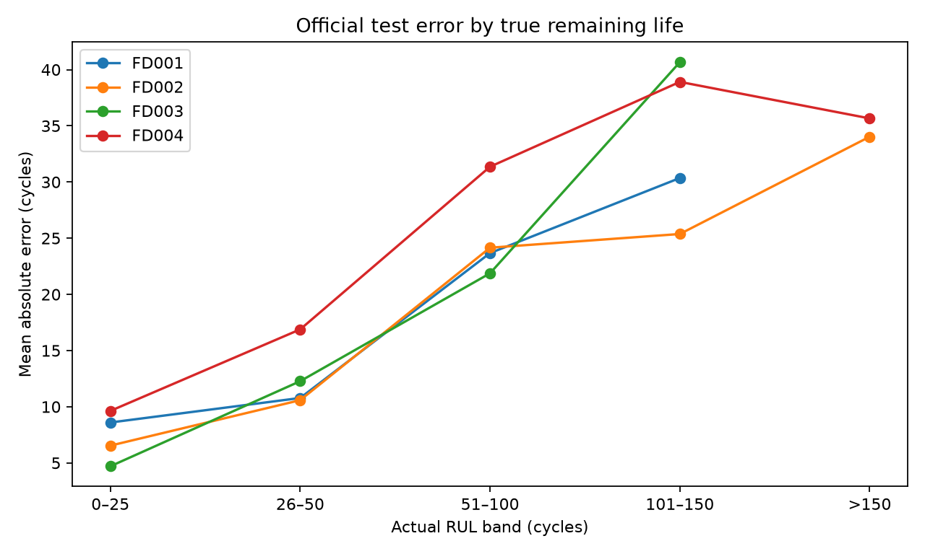
Error direction
Engines with overestimated life
FD001 65 / 100
FD002 150 / 259
FD003 76 / 100
FD004 175 / 248
Late predictions would matter most in a maintenance setting.
Notes:
Source: reports/modeling/error_direction_counts.csv and error_by_rul_band.png. Overestimation means predicted RUL exceeds true RUL.

Slide 14
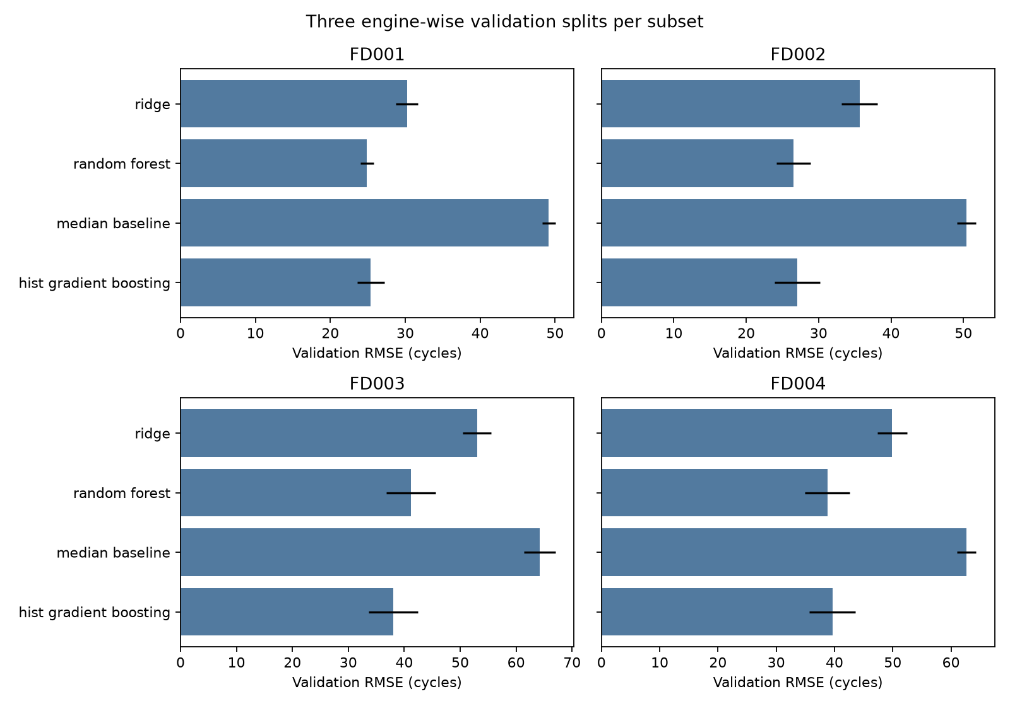
Robustness audit
FD002 and FD004 change mean-RMSE leader in this later audit.
Three repetitions show sensitivity. They do not provide a confidence interval.
Notes:
Source: reports/robustness/repeated_validation_rmse.png. Three training-only splits with endpoints at 50%, 70% and 85% of lifetime. This audit did not change official-test selections.

Slide 15
Research context and limitations
Literature survey
13 studies cover benchmark design, deep sequence models, feature engineering, uncertainty and explainability.
What our results cannot establish
Published scores use different targets and protocols. C-MAPSS is simulated. One original validation split and frequent overestimation limit conclusions.
No real-aircraft safety or deployment claim follows from these scores.
Notes:
Source: GROUP_ACTIVITY_REPORT_SOURCE.md, sections 3, 4 and 7.6–7.8. Key literature: Saxena et al. 2008 DOI 10.1109/PHM.2008.4711414; Ramasso and Saxena 2014 DOI 10.36001/ijphm.2014.v5i2.2236; Liu et al. 2023 DOI 10.3390/aerospace10080715.

Slide 16
Conclusion and next steps
Completed
Preserved raw data, checked quality, engineered causal features, compared four regressors and evaluated all four subsets on official test engines.
Next research steps
Repeated nested engine-wise validation, engine-balanced training, calibrated uncertainty and external data evaluation.
Repository: github.com/sohammj/Turbofan_RUL_ML
Notes:
Source: GROUP_ACTIVITY_REPORT_SOURCE.md, sections 8 and 9. Future work is proposed, not completed.

Slide 17
Proposed group contribution split
Soham
Project integration, protocol, result interpretation and report coordination
Hardik
Data provenance, raw structure and EDA interpretation
Farhaan
Data quality, RUL labels and feature engineering
Sanjeet
Model comparison, validation and reproducibility
Sparsh
Official test, plots, error analysis and presentation figures
Confirm actual work and fill roll numbers before submission.
Notes:
Source: GROUP_ACTIVITY_REPORT_SOURCE.md, Declaration and individual contribution table. These roles are proposed and require member confirmation before a signed declaration.

